Slide 1

Potential Features that Lead to Red Hat Business Value
Jalal • 09.03.2020

Slide 2
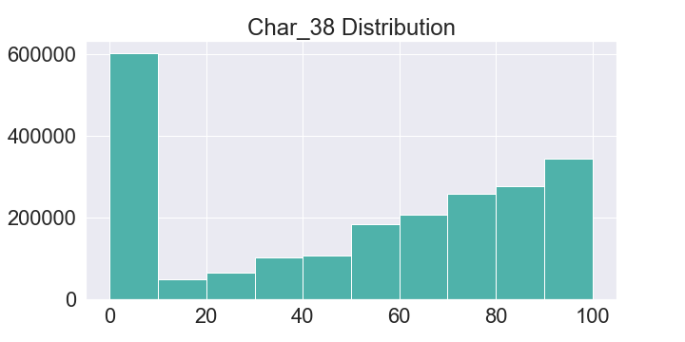
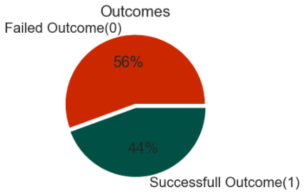
Most of the values are in Char_38 are condensed to the edges of the distribution.

Slide 3
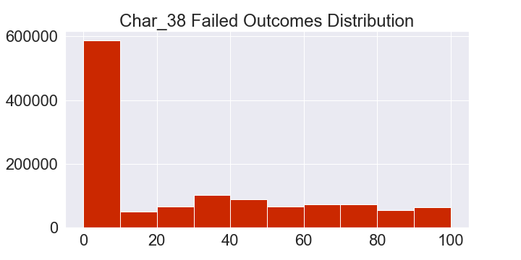
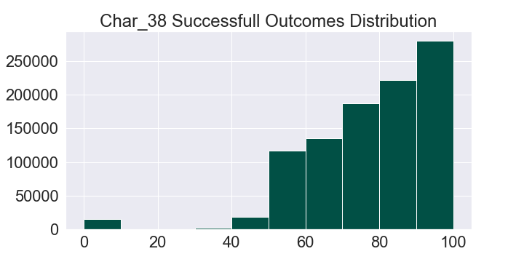
H0: There is no difference in the mean of char_38 with respect to successful outcomes and Failed outcome.
H1: There is a difference in the mean of char_38 with respect to successful outcomes and Failed outcome. (Claim)
Decision: There is enough evidence to reject the null hypothesis, that there is difference in the mean of char_38 with respect to successful outcomes and failed outcomes (p-value=0.0).

Slide 4
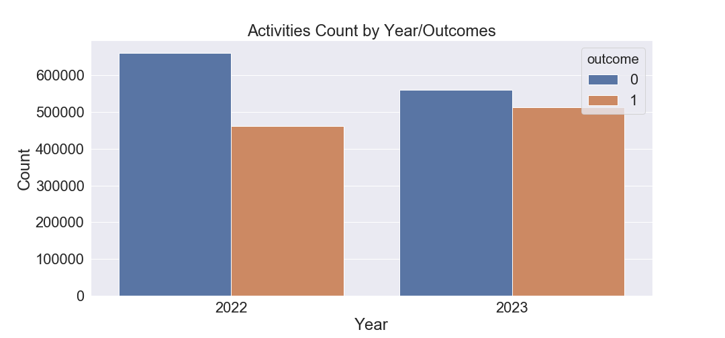
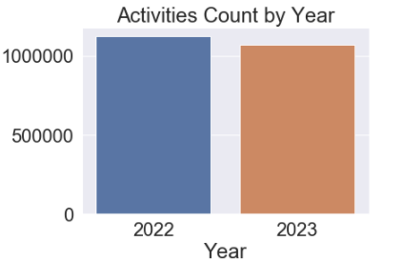
H0: There is no difference in the means of successful outcomes between year 2022 and year 2023.
H1: There is a difference in the means of successful outcomes between year 2022 and year 2023.
Decision: There is enough evidence to reject the null hypothesis, that there is no difference in the means of successful outcomes between year 2022 and year 2023 (p-value=0.0095).

Slide 5
Takeaways:
Recommendations:
Customers with higher numerical value in char_38 are more likely to be business values.
The business value increases over time, so there is more likelihood of business value in the later dates.
Future Project:
Building a model that can predict the business value of each customer based on all of their characteristics and activities.

